Slide 1
Employee Data Analysis using Excel
STUDENT NAME:HARI PRAKASH S
REGISTER NO:312207289
NAAN MUDHALVAN ID :1D6B82D7D5890DC85AD4911F99991AD4
DEPARTMENT:B.COM (GENERAL)
COLLEGE: C KANDASWAMI NAIDU COLLEGE FOR MEN

Slide 2
PROJECT TITLE
Employee Type Analysis using Excel Modeling

Slide 3


AGENDA
Problem Statement
Project Overview
End Users
Our Solution and Proposition
Dataset Description
Modelling Approach
Results and Discussion
Conclusion
3/21/2024 Annual Review

Slide 4

PROBLEM STATEMENT
Organizations often struggle to maintain an optimal balance between different types of employment contracts—permanent, fixed-term, and temporary—leading to inefficiencies, increased costs, and compliance risks. Without a clear understanding of the current workforce distribution and predictive insights, businesses face challenges in resource allocation, turnover management, and strategic workforce planning, ultimately impacting their ability to achieve operational efficiency and sustain competitive advantage.

Slide 5

PROJECT OVERVIEW
This project will analyzing and evaluating employees performance across various departments such as Human resources, marketing, Acconting, services, research and development, Legal, Support, Engineering.This project includes graphs and pie chart and this project will result in a comprehensive, user-friendly excel tool that can be regularly updated and used by HR and management to drive performance improvemets within the organistion.
.

Slide 6

WHO ARE THE END USERS?
Employees:
Individual Employees May have access to their performance data and metrics to self-assess and identify areas for personal improvement.
Business Organization:
Business Organization and Analysts Use the data to support performance reviews, identify training needs, and develop employee development plans.Recruitment Teams Analyze data to understand the skills and performance trends that are beneficial for hiring.

Slide 7

OUR SOLUTION AND ITS VALUE PROPOSITION
Solution: Workforce Analytics and Optimization Tool
This tool leverages data on employee types (permanent, fixed-term, temporary) to help organizations optimize their workforce structure, improve resource allocation, and reduce costs. It provides insights through advanced analytics and predictive modeling, helping HR and management make data-driven decisions.
Value Proposition:
1. Data-Driven Insights:
- Employee Type Distribution Analysis*: Understand the current distribution of workforce types to optimize HR strategies and ensure alignment with business goals.
- Predictive Workforce Planning*: Anticipate future workforce needs based on trends, enabling proactive hiring and resource allocation.
2. Cost Optimization:
- Cost-Benefit Analysis: Compare the costs associated with permanent, fixed-term, and temporary employees, helping organizations reduce unnecessary expenditures.
- Resource Allocation: Ensure that the right type of employment contract is used for the right role, minimizing labor costs while maintaining productivity.
3. Risk Management:
- Compliance and Regulatory Support: Ensure the organization is compliant with labor laws regarding different types of employment contracts, reducing legal risks.
- Turnover Prediction and Management: Use predictive models to foresee turnover in temporary or fixed-term roles, allowing for better succession planning.
4. Strategic Decision Making:
- Scenario Planning: Simulate different scenarios to understand the impact of changing the mix of employee types on overall business performance.
- Talent Acquisition Optimization: Identify the most cost-effective and strategically beneficial mix of employee types for specific departments or projects.

Slide 8
Dataset Description
The dataset for employee performance analysis typically includes various metrics that reflect
an employee's productivity, quality of work, attendance, and overall contribution to the
organization. Below is a description of the key columns that would be included in a Actionable Insights which Include recommendations or action items based on the analysis, such as training needs or performance improvement plans.
Excel dataset:
EmpID: A unique identifier for each employee.
Employee Name: The employee’s given name.
Gender Code: A code representing the gender of the employee (e.g., M for Male, F for Female, etc.)
Business Unit: The department or division within the company where the employee works.
Employee Salary: The amount of salary that the empoyee gets for their work.
Employee Type: Classification of the employee, such as full-time, part-time, contractor, etc.
Employee location: Location of the employee where he works.

Slide 9

THE "WOW" IN OUR SOLUTION
wow" features combine to create a powerful,
efficient, and intuitive Excel-based solution that
not only meets but exceeds expectations in
managing and analyzing employee
Performance. The solution includes an AI-driven feature that suggests actionable improvements based on performance trends, helping managers to implement effective strategies for boosting productivity and employee engagement. To improvement. This holistic view promotes better strategic decision-making.
3/21/2024 Annual Review
9

Slide 10
MODELLING
If you're referring to statistical or predictive modeling based on the employee data, here’s a brief overview:
1. *Descriptive Modeling*:
- Summarizes the data, as seen in the charts.
- For instance, you could use measures like mean, median, or mode to understand employee distribution better.
2. *Predictive Modeling*:
- Forecasts future trends in employee types based on current data.
- You could use logistic regression, decision trees, or other classification algorithms to predict the likelihood of an employee being permanent, fixed-term, or temporary.
3. *Clustering*:
- Groups similar employee types or patterns within the data.
- K-means clustering or hierarchical clustering could identify patterns or subgroups among the employees.
These models help in understanding current trends and making informed decisions for future workforce planning. If you need further assistance with specific modeling, let me know!
10

Slide 11
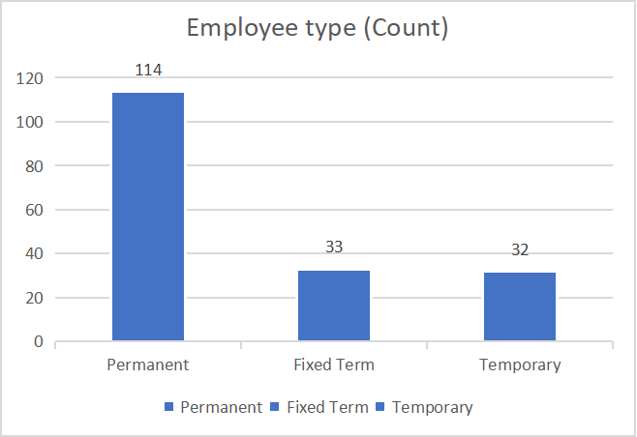
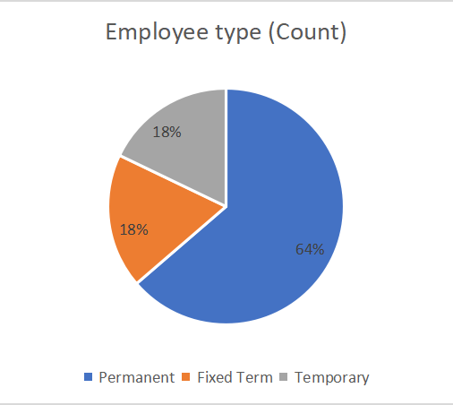
RESULTS
It looks like you've uploaded two images showing different visualizations of employee types based on counts. Here’s what each image represents:
1. *Pie Chart*: This shows the distribution of employee types as percentages:
- Permanent: 64%
- Fixed Term: 18%
- Temporary: 18%
2. *Bar Chart*: This displays the exact count of each employee type:
- Permanent: 114 employees
- Fixed Term: 33 employees
- Temporary: 32 employees
If you need further analysis or additional information, feel free to ask!
11

Slide 12
conclusion
This Excel-based approach provides a scalable, adaptable, and efficient method for enhancing employee performance management.By leveraging data analytics, the organization can foster a culture of continuous improvement and drive overall success.Implemented an Excel-based solution for systematic employee performance analysis.Addressed the lack of consistency in evaluating performance, leading to more informed decision-making.Enabled identification of top performers, areas needing support, and overall productivity trends.Enhanced data-driven insights for management and HR.Streamlined reporting processes and reduced manual effort.Improved employee engagement and targeted development strategies.Regular updates and refinements to the model based on feedback.Integration with other data sources for a more holistic view.Continuous training for end-users to maximize tool effectiveness.

